Slide 1
A Simple Syntax Directed Translation
Muhammad Haris
Lecturer Computer Science
Sukkur IBA University Kandhkot Campus

Slide 2
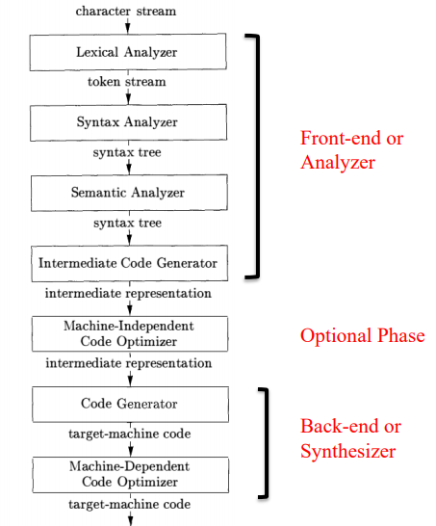
Recap. Lecture 1 Structure of Compiler
Symbol Table

Slide 3
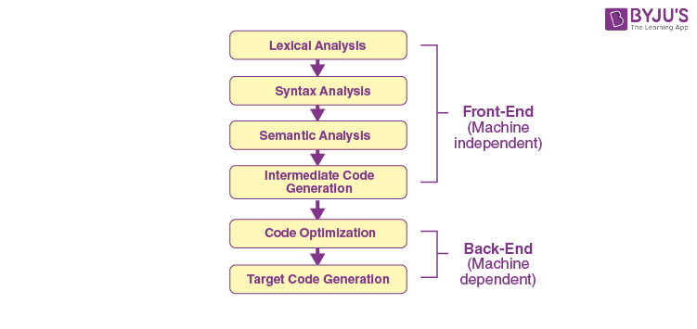

Slide 4
Analysis
The analysis phase of a compiler breaks up a source program into constituent pieces and produces an internal representation for it, called intermediate code.
Lexical Analysis,
Syntax and Semantics Analysis,
Intermediate Code Generation.

Slide 5
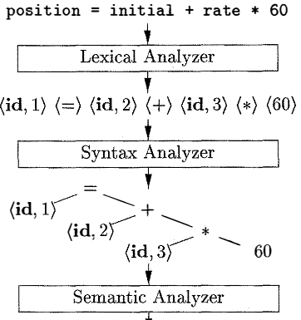

Slide 6
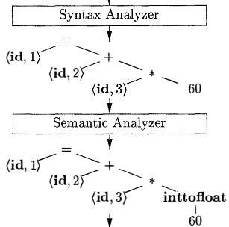

Slide 7

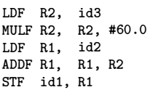
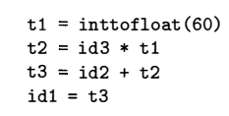

Slide 8
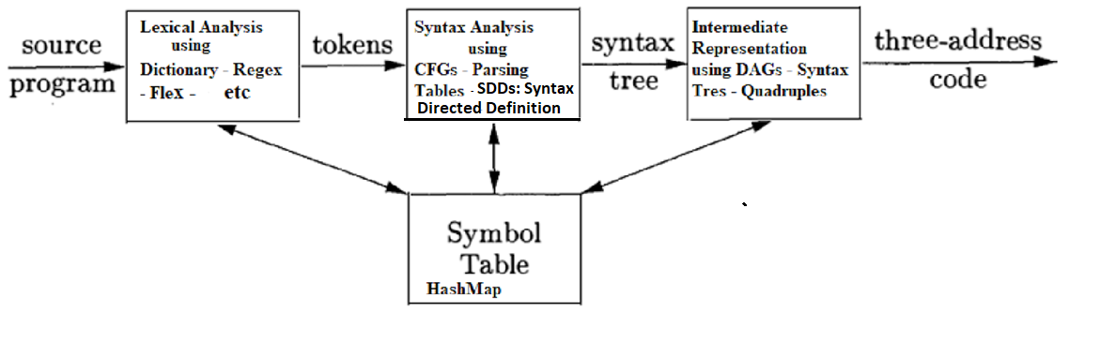
A Syntax Directed Translation Tools and Techniques

Slide 9
Context Free Grammar
A set of terminal symbols, may be referred to as “tokens”.
A set of non-terminals, may be called “syntactic variables”.
A designation of one of the non-terminals as the start symbol.
A set of productions, where each production consists of a
Non-terminal, called the head or left-side of the production,
an arrow, and
a sequence of terminals and/or non-terminals , called the body or right side of the production.

Slide 10
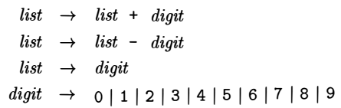

CFG Example
lists of digits separated by plus or minus signs .
OR
The string of zero terminals, written as є, is called the empty string.

Slide 11

Syntax → CFG
Using the variable expr to denote an expression and the variable stmt to denote a statement , this structuring rule can be expressed as:
Such a rule is called a production.
In a production, lexical elements like the keyword if and the parentheses are called terminals.
Variables like expr and stmt represent sequences of terminals and are called non-terminals.

Slide 12
Parse Trees
Parsing is the problem of
taking a start symbol and
figuring out how to derive a string of terminal from the it following the grammar rules
And if it cannot be derived from the start symbol of the grammar , then reporting syntax errors within the string.

Slide 13
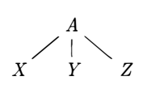
Parse Trees
A parse tree pictorially shows how the start symbol of a grammar derives a string in the language.
If non-terminal A has a production A → XYZ, then a parse tree may have an interior node labeled A with three children labeled X, Y, and Z, from left to right:

Slide 14
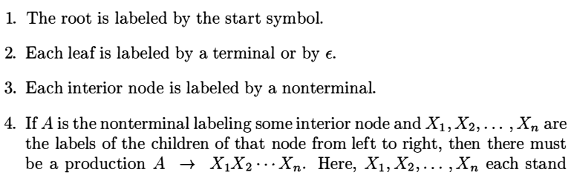
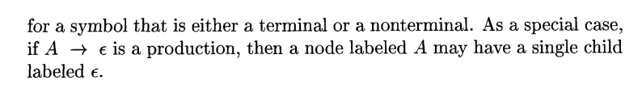
Parse Trees

Slide 15
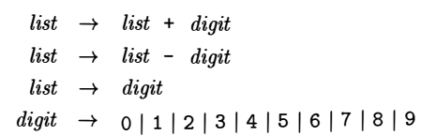
Parse Trees
The process of finding a parse tree for a given string of terminals using a predefined CFG, is called parsing.
Such as 9-5+2
Can you parse it?

Slide 16
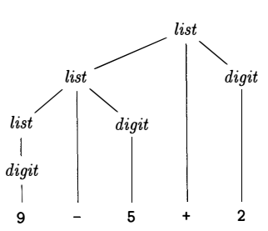
Parse tree Example
The derivation of 9-5+2

Slide 17
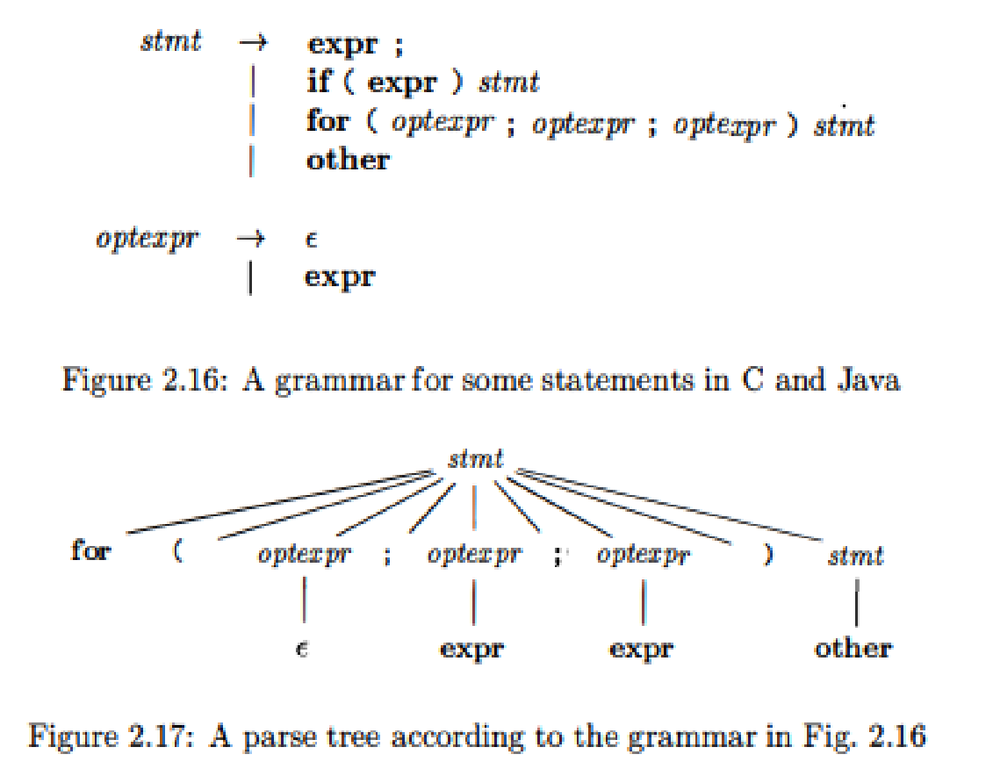
Input: for ( ; expr ; expr )

Slide 18
Ambiguity
A grammar can have more than one parse trees generating a given string of terminals.
Such a grammar is said to be ambiguous.
Since a string with more than one parse trees usually has more than one meaning,
we need to design unambiguous grammars for compiling applications, or to use ambiguous grammars with additional rules to resolve the ambiguities .

Slide 19
Consider a CFG - E → E+E E → E*E E → id Can you parse id+id*id ?

Slide 20
Parsing id+id*id E → E+E |E*E | id
E
E
E
E
E
E
+
*
E
E
E
E
id
id
*
+
id
id
id
id

Slide 21
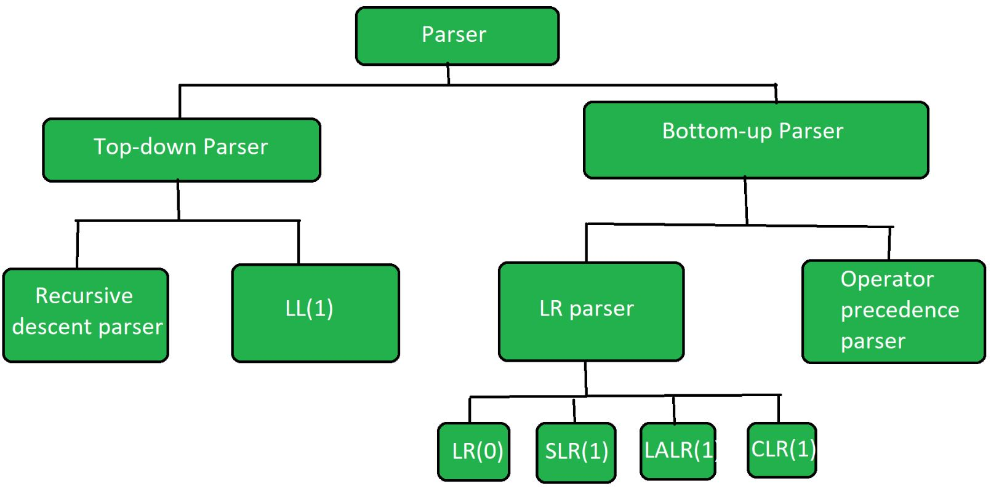

Slide 22
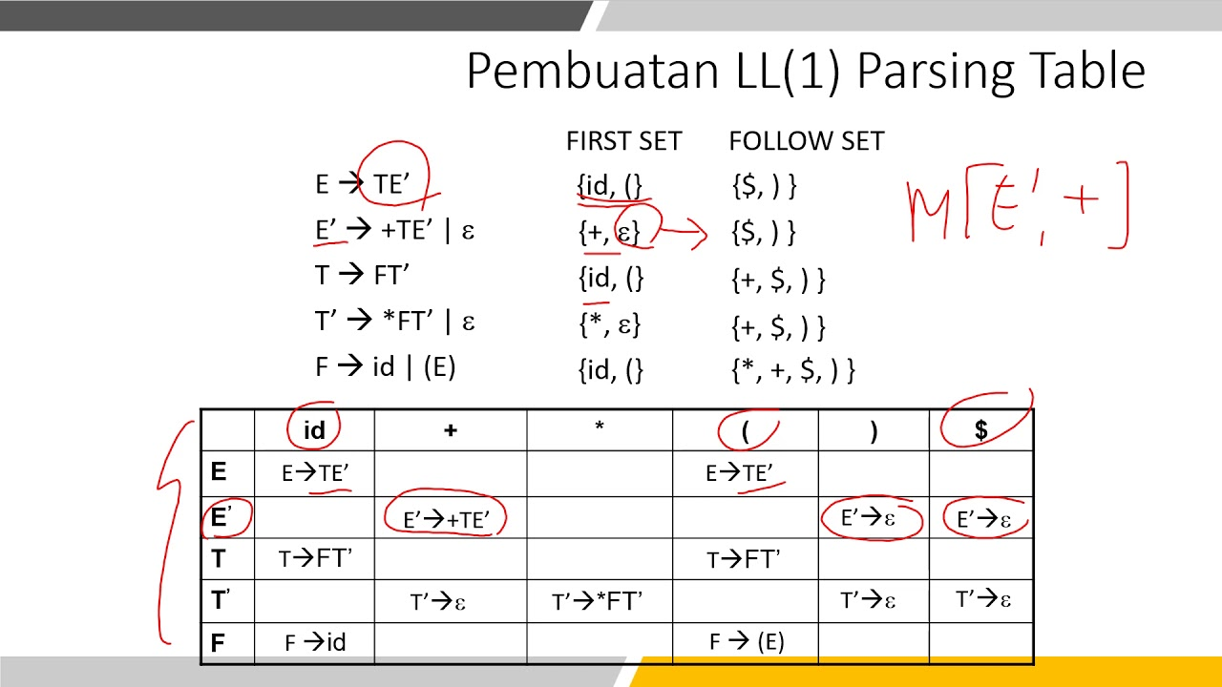

Slide 23
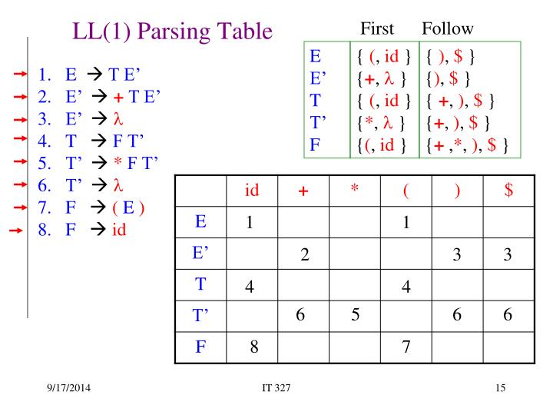

Slide 24
